Slide 2
What are HIV-specific CD8 T cells missing to kill the enemy?
Lydie Trautmann
@TwitterHandle
Share your thoughts on this presentation with #IAS2019
The views expressed are those of the authors and should not be construed to represent the positions of the U.S. Army, the Department of Defense, or HJF.

Slide 3
Disclosure
The author has no conflict of interest to disclose
The views expressed are those of the authors and should not be construed to represent the positions of the U.S. Army, the Department of Defense, or HJF

Slide 4
Viral control in SIV can be mediated by CD8 T cells
CD8 T cell depletion leads to viral rebound, suggesting viral control mediated by CD8 T cells in:
  ART treated SIV-infected macaques
  Macaques who received bNAbs early after SHIV infection and showed sustained control
Cartwright E, Immunity 2016
Nishimura Y, Nature 2017
Deplete
CD8, NK, NKT,
γδ T
Deplete
CD8
3BNC117+10-1074 bNAbs
at days 3, 10 and 17
control SHIV viremia
Loss of viremic control
with CD8 depletion

Slide 5
CD8 T cells are not enough to induce HIV control
HIV-specific CD8 T cells control HIV replication only in elite controllers
HIV-specific CD8 T cells are dysfunctional in chronic infection
Post-treatment controllers do not show CD8-mediated control
Therapeutic vaccines have not induced HIV remission so far
Fellay J, Science 2007; Pereyra F, Science 2010
Day C, Nature 2006; Trautmann L, Nat Med 2006
Sáez-Cirión A, PLoS Pathog 2013
Pollard RB, Lancet Infect Dis 2014
Sneller MC, Sci Transl Med 2017

Slide 6
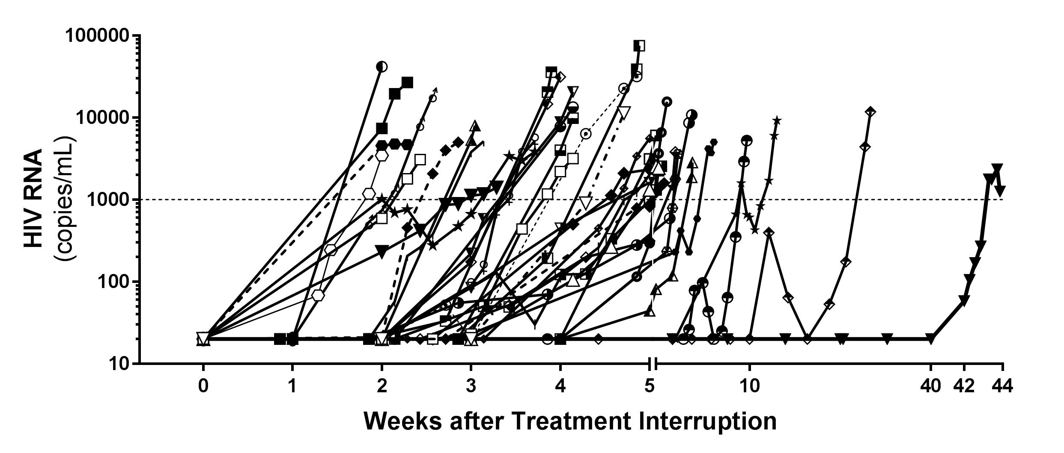
CD8 T cells are not enough to induce HIV control even when the reservoir is small
ART initiation in acute infection did not lead to HIV control after ART cessation
Colby DJ, Nat Med 2018
Tue 23 July,
“HIV remission and control trials”
Sacdalan C
HIV-specific CD8 T cells negatively correlated with plasma VL at ART reinitiation in people who initiated ART in FI but not in other Fiebig
Viral rebound after ART interruption in RV254 participants who started ART in acute infection
RV254 participants

Slide 7
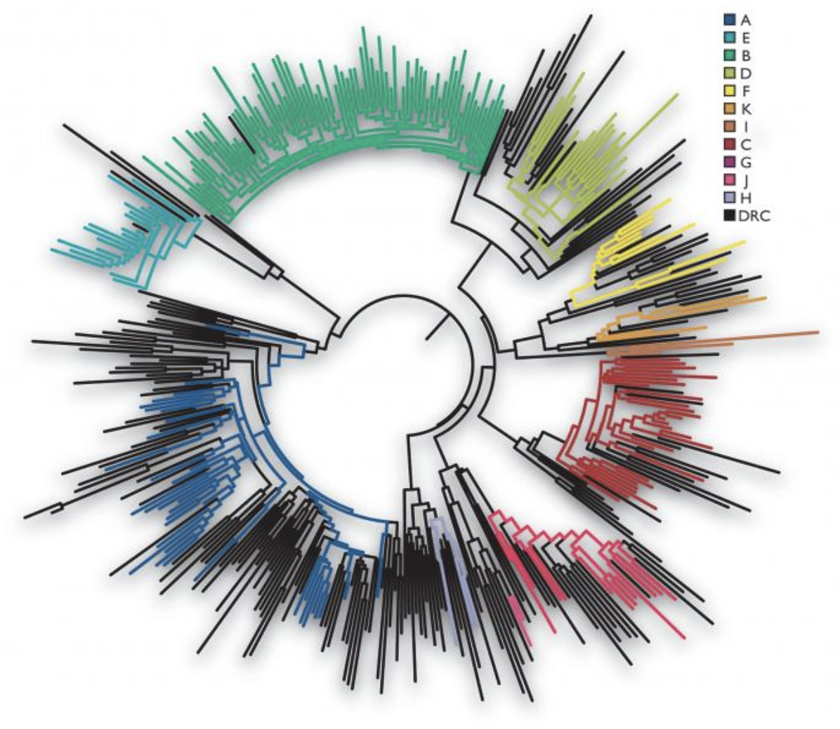


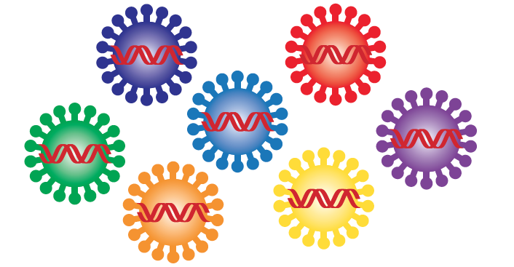

Different features of immune responses for prevention and treatment
For prevention, immune responses need to:
Block one virus at site of entry in mucosa
Be persistent over time after vaccination
Target multiple HIV clades
For treatment, immune responses need to:
Block a swarm of virus at multiple sites in the body
Be potent at ART interruption
Target HIV variants in one individual
T cell responses need to be:
Broad
Potent and sensitive
Numerous and fast
Notes:
We don’t know yet what immune responses are needed to control viremia post treatment interruption but we know already some features they need to have. For prevention, immune responses need to block the virus entry at a single site whereas for treatment, they need to block a swarm of viruses at multiple sites of the body. Therefore these immune responses need to be potent and strong after ART interruption whereas for prevention they need to persist overtime as the time between vaccination and HIV exposure is unknown. These responses also need to be broad, as for treatment they need to target different variants that have emerged on a single individual but for prevention even broader as they need to be efficient against different HIV clades represented here by different colors in this phylogenetic tree.

Slide 8
Outline
Are HIV-specific CD8 T cells missing breath?
Do they have enough affinity to eliminate HIV-infected cells?
Are they too exhausted even on ART?
What are they missing when ART is initiated in acute infection?
Where do we go from there?

Slide 9
Breadth of HIV-specific CD8 T cells
Few epitopes are required in SIV to induce control
Large breadth developed after RhCMV vaccine that induces 60% protection
HIV-specific CD8 T cells were detected in the blood in Fiebig II/III
Limited number of epitopes recognized in AHI with increased breadth over time
Limitations of these studies:
  Limited number of donors studied in Fiebig I/II
  Assays not very sensitive
  CD8 T cells at peak viremia in AHI have a reduced cytokine response after in vitro stimulation
Mudd PA, Nature 2012
Hansen SG, Nature 2011 and 2013
  Turnbull EL, J Immunol 2009; Goonetilleke, JEM 2009
  Radebe, JID 2011; Radebe, AIDS 2015
  Trautmann, Blood 2012; Ndhlovu, Immunity 2015, Takata Sci Transl Med 2017
Notes:
How much breadth of CD8 responses is needed to control HIV is still unresolved and data from the SIV model are arguing on both sides:
A study demonstrated that as few as 3 epitopes were sufficient to induce SIV control, but the RhCMV vaccine that induces 60% protection is generating an unusual large breadth of response.

Slide 10
Breadth of HIV-specific CD8 T cells in acute infection
Frequency of HIV-specific CD8 T cells in AHI and CHI
Breadth of HIV-specific CD8 T cells in AHI and CHI
HIV protein coverage by HIV-specific CD8 T cells in AHI
 | FI | FII | FIII | FIV/V | CHI
Mean | 3.8 | 8.6 | 8.7 | 11.0 | 9.8
Min-Max | 0-7.5 | 1.5-18 | 3-19.5 | 4-16.5 | 0-18
Estimate number of peptides recognized in a single person
Breadth of HIV-specific CD8 T cell responses in acute infection averages 10 epitopes and is identical to chronic infection starting in Fiebig II and cover all HIV proteins
Subra C, unpublished
RV254 participants

Slide 11
Killing reactivated HIV-infected cells on ART
HIV-specific CD8 T cells in AHI impact viral set point Streeck H, J Virol 2014; Ndhlovu et al, Immunity 2015
HIV-specific CD8 T cells impact HIV reservoir seeding after ART initiation Takata STM 2017
But HIV-infected cells might be different during productive infection and after reactivation from the latent reservoir pool
Reactivated latently-infected cells may be resistant to HIV-specific CD8 T cell killing
Infected CD4 T cells in HIV infection harbor more defective viruses than in SIV infection
Reactivated latently infected CD4
T cell
Productively infected CD4
T cell
Good target
Difficult target
Huang SH, J Clin Invest 2018
Bender AM, Cell Host Microbe 2019

Slide 12
TCR affinity influences HIV reservoir cells killing
HIV-specific CD8 T cells with high affinity TCR better control viral replication
Almeida JR, J Exp Med 2007; Almeida JR, Blood 2009
Nef-specific
Gag-specific
Gag-specific
CD8- CD8-
dependent independent
HIV-specific CD8 T cell clones with high affinity TCR (CD8-independent) have a better reservoir killing capacity
Lima NS, submitted

Slide 13
HIV-specific CD8 T cell numbers and function on ART
ART reduces the frequencies of HIV-specific CD8 T cells
ART partially restores polyfunctionality, and normalizes activation, exhaustion markers and survival markers
ART in acute infection limits PD-1 expression
on HIV-specific CD8 T cells and preserves their
proliferation capacity
Ogg GS, J Immunol. 1999; Cassaza JP, J Immunol. 2001
Rehr M, J Virol. 2008; Janbazian L, J Immunol. 2012; Vigano S, J Virol. 2015; Mahnke YD, Pathog Immun 2016
Fiebig I
Fiebig II
Fiebig III
Fiebig IV/V
Chronic
Wed 24 July,
“Pathogenesis: And the band plays on”
Takata H
RV254 participants

Slide 14
HIV-specific CD8 T cells from people treated in acute infection have superior killing capacity but have lower cell number than that from treated in chronic infection
HIV-specific CD8 T cell numbers and function on ART
Wed 24 July,
“Pathogenesis: And the band plays on”
Takata H
Absolute cell number in peripheral blood
Recalled HIV-specific CD8 T cells
Fiebig I
Fiebig I
Fiebig II
Fiebig II
Fiebig III
Fiebig III
Fiebig IV/V
Fiebig IV/V
Chronic
Chronic
RV254 participants

Slide 15
Summary
HIV-specific CD8 T cell features:
Generated early in Fiebig I
Have a breadth and coverage at peak viremia similar to chronic infection
Impact viral set point and reduce reservoir seeding in acute infection
HIV-specific CD8 T cell responses after ART:
Need to have high TCR affinity to eliminate reactivated HIV-infected cells
Do not recover proliferation and cytotoxic potential if not treated in acute infection
Contribute to lower viral load at rebound following ATI only if treated in Fiebig I
Do not have sufficient numbers when ART initiated in acute infection

Slide 16
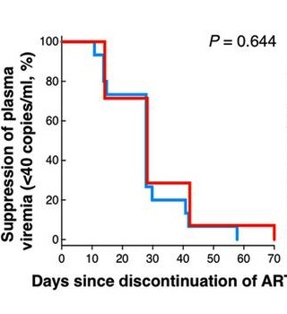
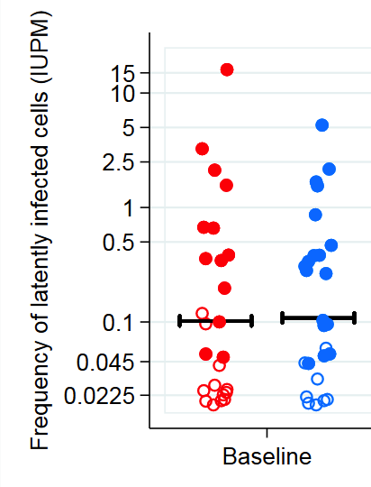
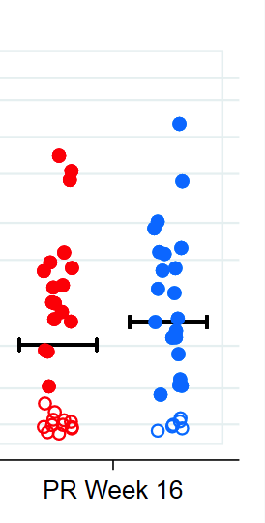

Therapeutic vaccines: a high bar
pDNA vaccine
Vorinostat + ChAd63/MVA
+
Viral outgrowth assay
T
ART only
ART + LRA + Vaccine
~ 100 therapeutic vaccines tested, the vast majority showing no effect
Sneller, Sci Trans Med 2017; Fidler, AIDS2018

Slide 17
Where to we go from there?
Lower reservoir
Not strong enough
Not low enough
Stronger immunity
immunity
Higher numbers?
Higher breadth?
Higher affinity?
Location?
latent
virus
HIV reservoir 10 -100 times lower than in Fiebig I needed
Rapid HIV-specific CD8 T cell
response needed
Hill, PNAS 2014 and Plos Pathogens 2016; Henrich, 2017 IAS
Migueles, Nature Immunol 2002; Walker-Sperling, JV 2015

Slide 18
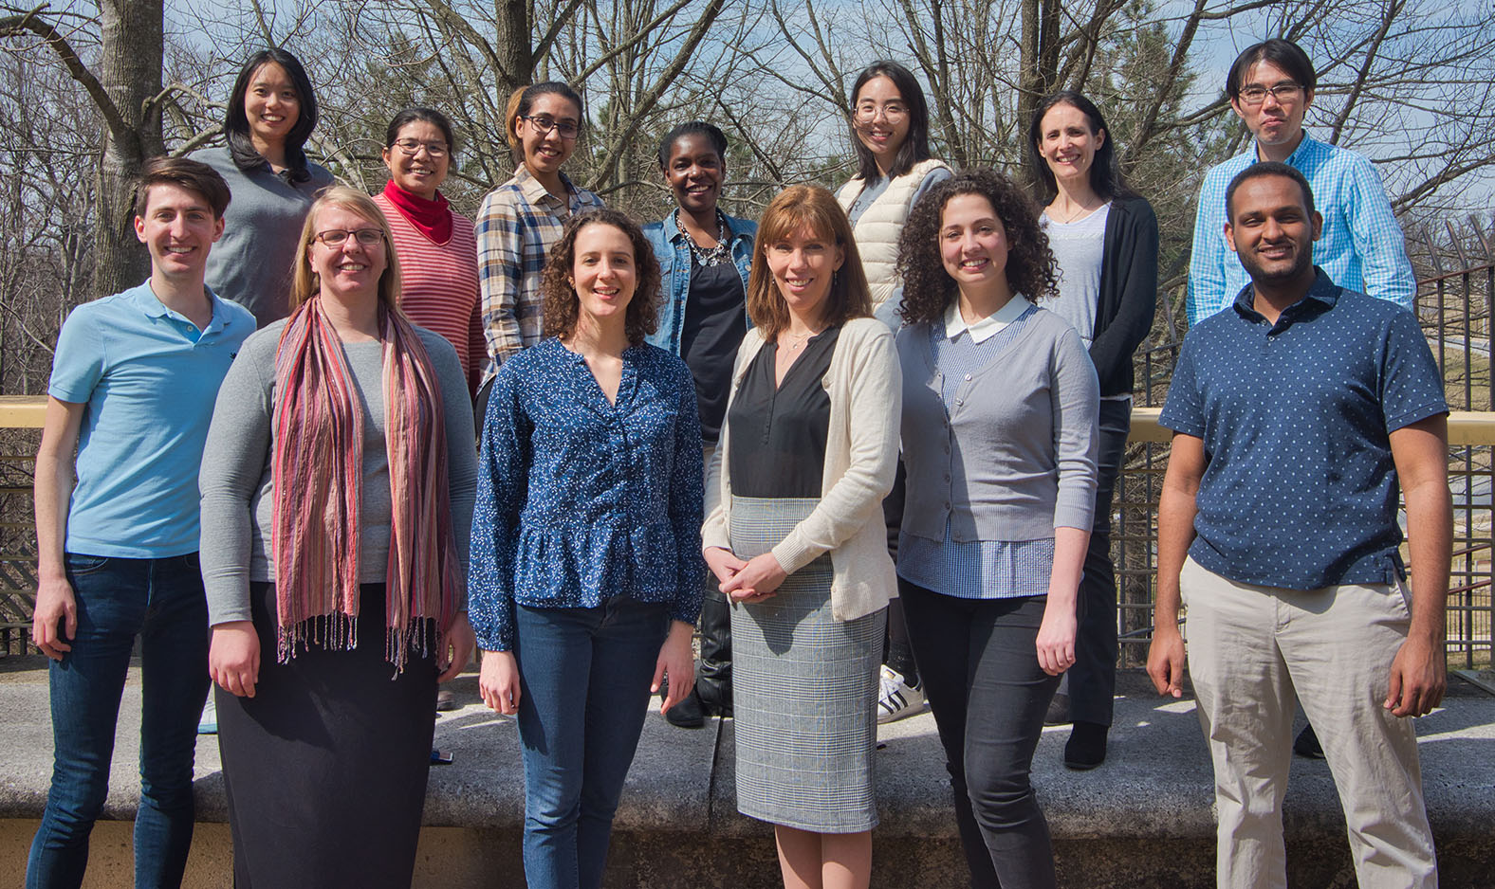
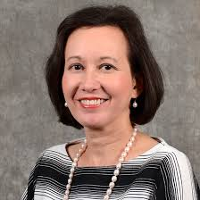
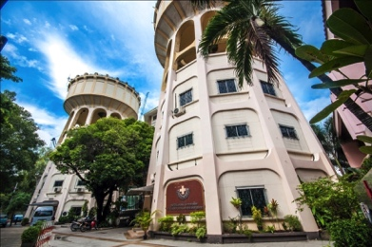
Acknowledgements
Participants of RV254 and Remission trials
MHRP Cellular
Immunology Section
Hiroshi Takata
Caroline Subra
Julie Mitchell
Noemia Lima
Faria Fatmi
Jueyon Kakazu
Shu-Wei Wu
Kelsi Jameson
Kenneth Dietze
Alexander Haregot
Nikiah Dawson
Montréal U
Nicolas Chomont
Louise Leyre
Remi Fromentin
U.S. MHRP
Nelson Michael
Sandhya Vasan
Merlin Robb
Robert Gramzinski
Jintanat Ananworanich
Julie Ake
Diane Bolton
Morgane Rolland
Sodsai Tovanabutra
Rasmi Thomas
Mark de Souza
Linda Jagodzinski
Shelly Krebs
Trevor Crowell
Suteera Pinyakorn
Flow Core
Drexel U
Elias Haddad
Roshell Muir
Yale
Serena Spudich
UCSF
Victor Valcour
Thai Red Cross
Praphan Phanuphak
Nipat Teeratakulpisarn
Nittaya Phanuphak
Eugene Kroon
Donn Colby
Nitiya Chomchey
Carlo Sacdalan
James Fletcher
Pornpen Tantivitayakul
Phillip Chan
Jintana Intasan
Many more
AFRIMS
Robert O’ Connell
Alexandra Schuetz
Siriwat Akapirak
Denise Hsu
Rapee Trichavaroj
Bessara Nantapinit
Pornsuk Visudhiphan
COG
Chulalongkorn U
Supranee Buranapraditkun
Sunee Sirivichayakul
Rungsun Rerknimitr
Sukalya Lerdlum
Phandee
Wattanaboon-
yongcharoen
Sopark Manasnayakorn
Cornell U
Brad Jones
Szu-Han Huang
Industry
Thai Gov Pharm Organization
ViiV Healthcare
Gilead
Merck
Monogram
Funding from U.S. MHRP Program, R01AI108433, R01MH106466

